Slide 1
Development of a UAV Platform for Remote Inspection and Visualization
Yeen K. Lee¹, Sean Bainard¹, Michael Shaughnessy¹, Matt Bolger¹, R. Tucker Koepp¹, Roya Salehzadeh¹, Stephen Mallory¹, James A. Mynderse¹, Pedro Guillen², Margarita Hernandez²
¹Lawrence Technological University, Southfield, MI
²Centrepolis Accelerator, Southfield, MI
2026 NDIA Ground Vehicle Systems Engineering and Technology Symposium
Autonomy & Robotics Technical Session • August 11–13, 2026 • Novi, Michigan

Slide 2
Autonomous UAVs Provide Essential Information for First Responders
GPS-Denied Indoors
Indoor reconnaissance can't rely on GPS. The platform must navigate complex interiors on its own.
Operator Cognitive Load
Manual flight in tight spaces overwhelms operators. High autonomy lets responders focus on the mission, not the sticks.
Raw Data ≠ Intelligence
Telemetry and 2D video flood incident commanders. The system must turn sensor readings into actionable decisions.
First responders need eyes inside hazardous spaces, active fires, structural collapse, chemical leaks, without putting people in harms way

Slide 3
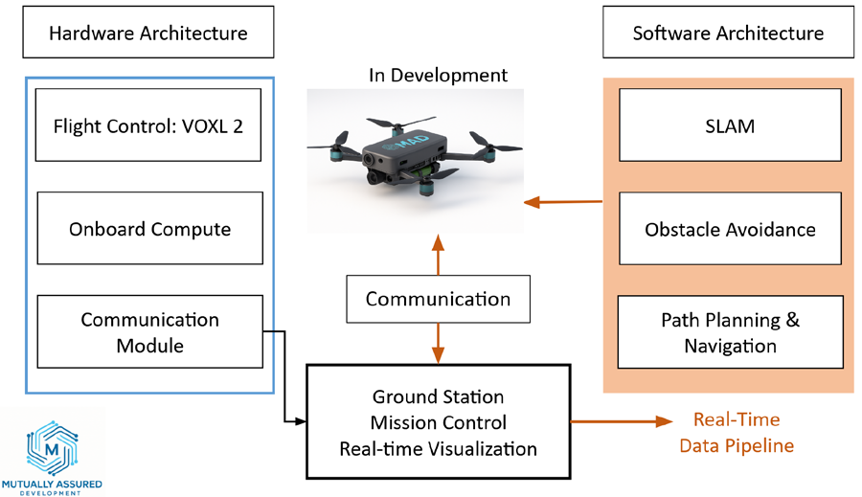
An intelligence and inspection platform with three integrated components
1. Attritable sub-250g UAV
Onboard sensing, obstacle avoidance, and SLAM for full autonomy in GPS-denied interiors.
2. Ground Control Station
Sensor fusion, data cleansing, and initial analysis via a ROS 2 pipeline.
3. Visualization Interface
A high-fidelity real-time 3D digital twin that turns data into decisions.

Slide 4
Sensors swap to fit the mission
IMU
UAV stabilization
RGB Camera
Visual navigation & mapping
ToF Camera
Depth estimation
Thermal Camera
Detect fires & people
Gas Sensors
Evaluate chemical leaks
Microphones
Communication
Customer discovery with first responders defined the UAV targets: low cost, long flight time, and an interchangeable mission-specific sensor suite — using all Blue UAS certified components.
Sub-250g limits a single airframe: missions split sensors across multiple UAVs
The initial build carries RGB, ToF, and thermal

Slide 5
Compute Architecture for Autonomy
The Mass Constraint
Discrete boards (Raspberry Pi, standalone MCUs) were evaluated and rejected.
Wiring, connectors, and mounting hardware add parasitic mass.
Individually minor — but collectively they exceed the available mass margin.
The Solution: VOXL 2
ModalAI VOXL 2 integrates flight control and companion compute on a single board.
One integrated platform eliminates interconnect mass while delivering the processing headroom SLAM requires.
Notes:
Adding SLAM-based autonomous navigation demands serious onboard processing; pairing a flight controller with a companion board.

Slide 6
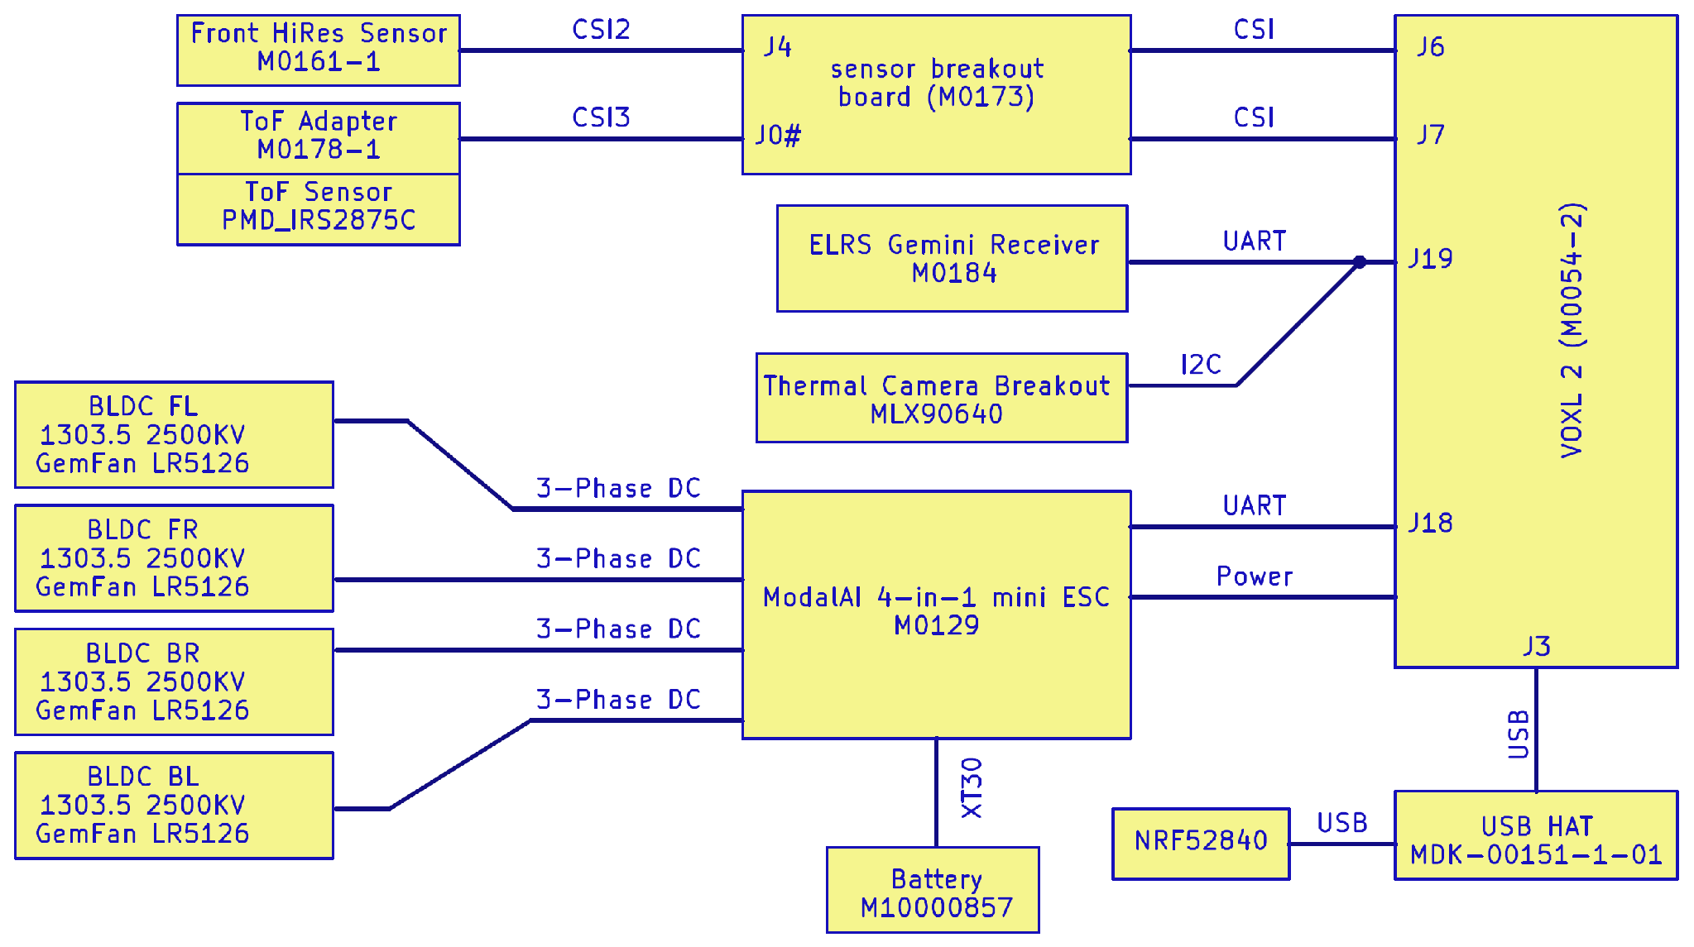
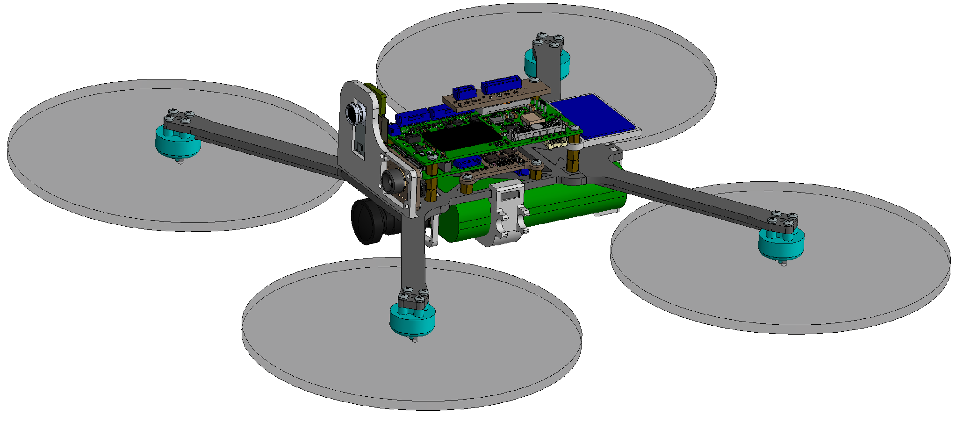
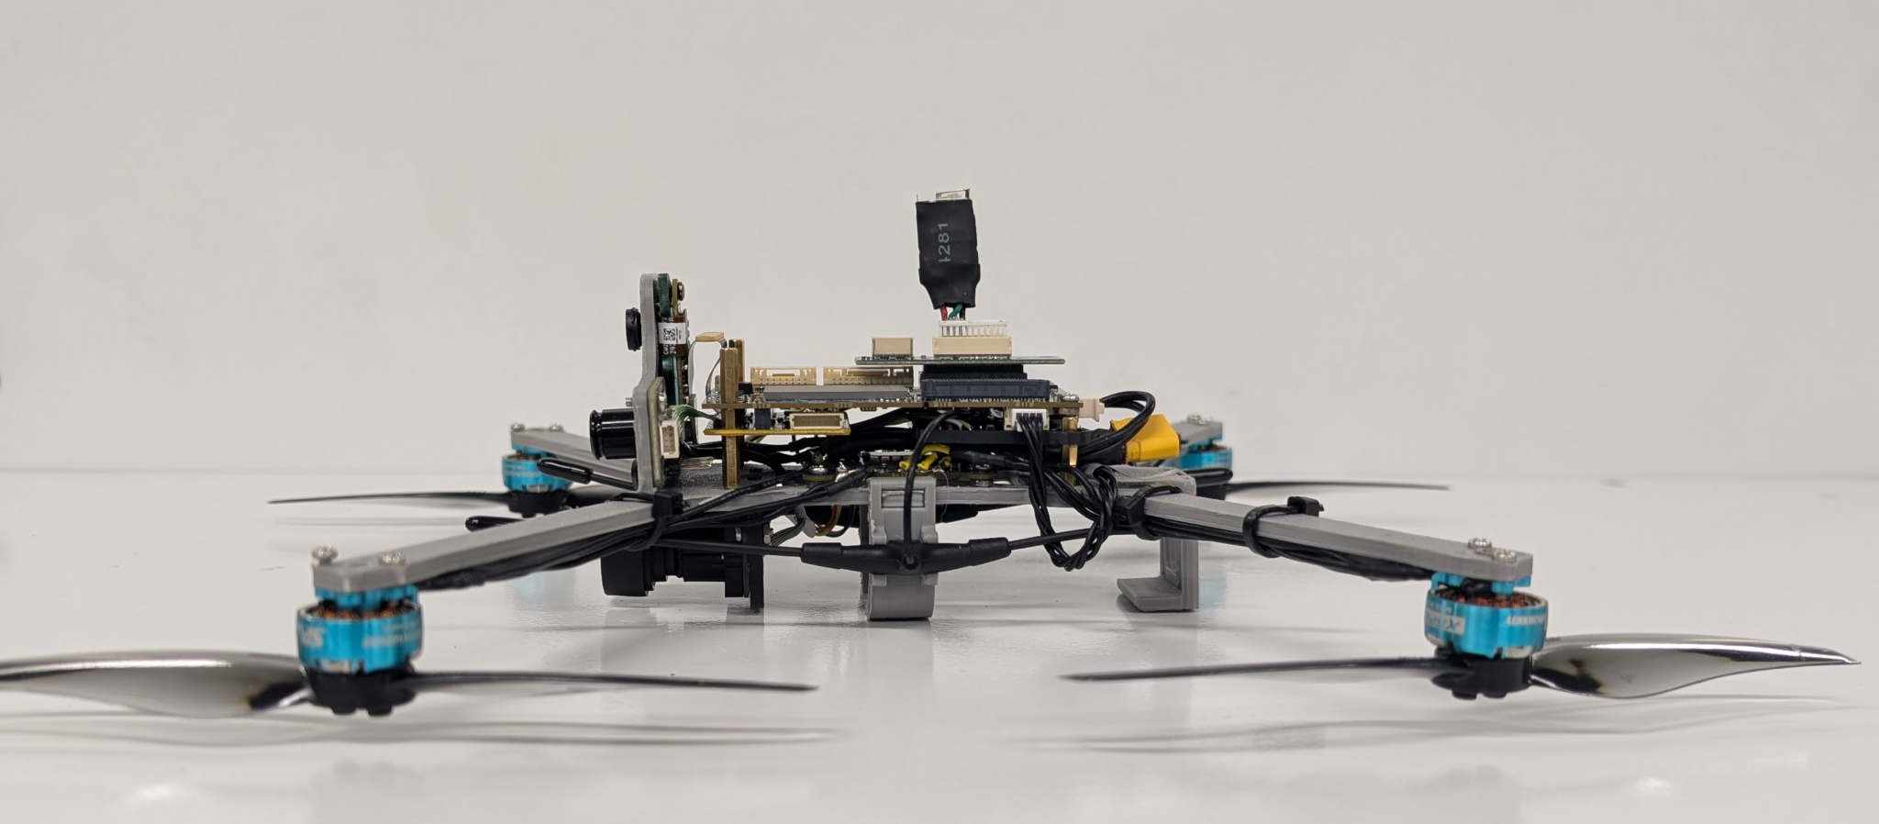
Chassis Design for Mass Priority
SCREEN
mass, ROS 2, availability
WEIGHT
pairwise, mass-priority
SCORE
7-criteria matrix
SELECT
max score + risk check

Slide 7
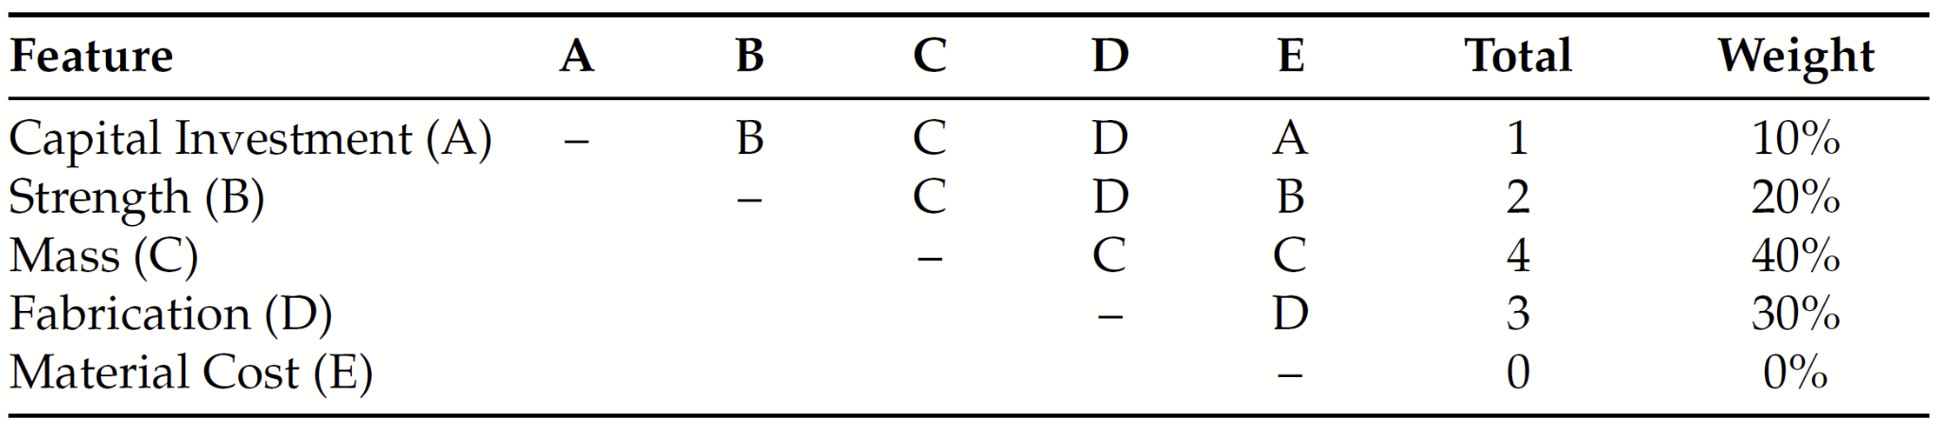
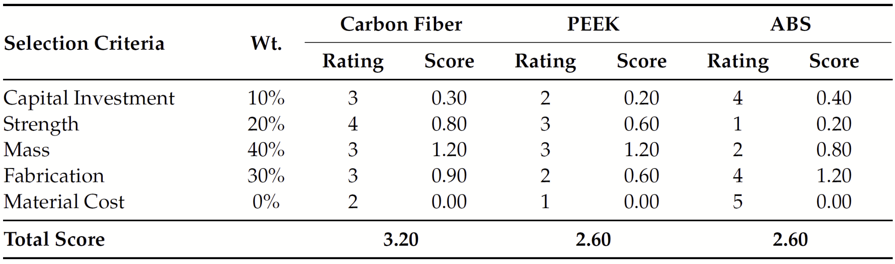
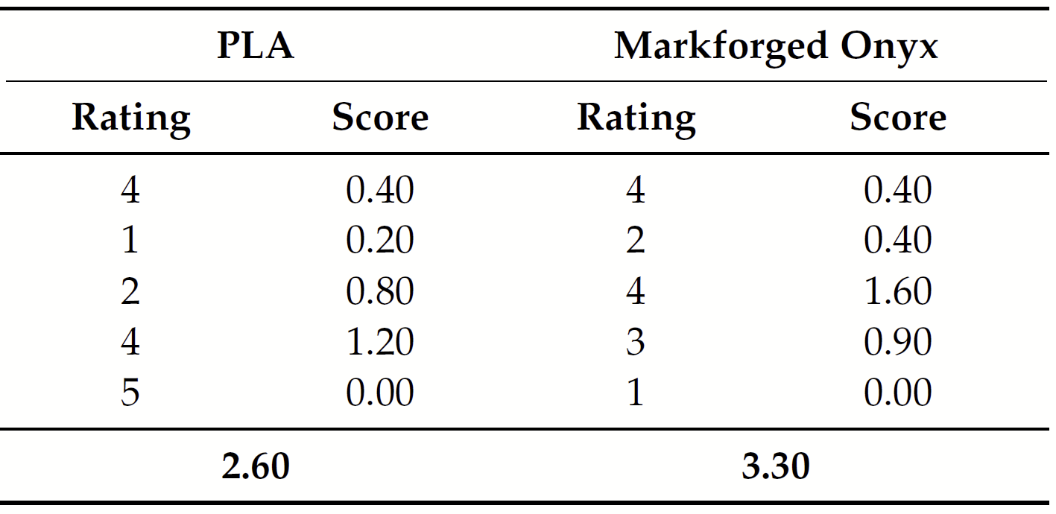
Chassis Material Selection
Salehzadeh, R.; Ortolan, C.; Mogulla, A.R.; Zia, A.K.M.; Stepanek, S.; Lee, Y.K.; Mynderse, J.A. System Design and Evaluation of a Lightweight Micro-UAV for Emergency Response. Drones 2026, 10, 413. https://doi.org/10.3390/drones10060413
Notes:
Interim builds: carbon-fiber-reinforced PLA (FDM) and a machined carbon-fiber composite slab.

Slide 8
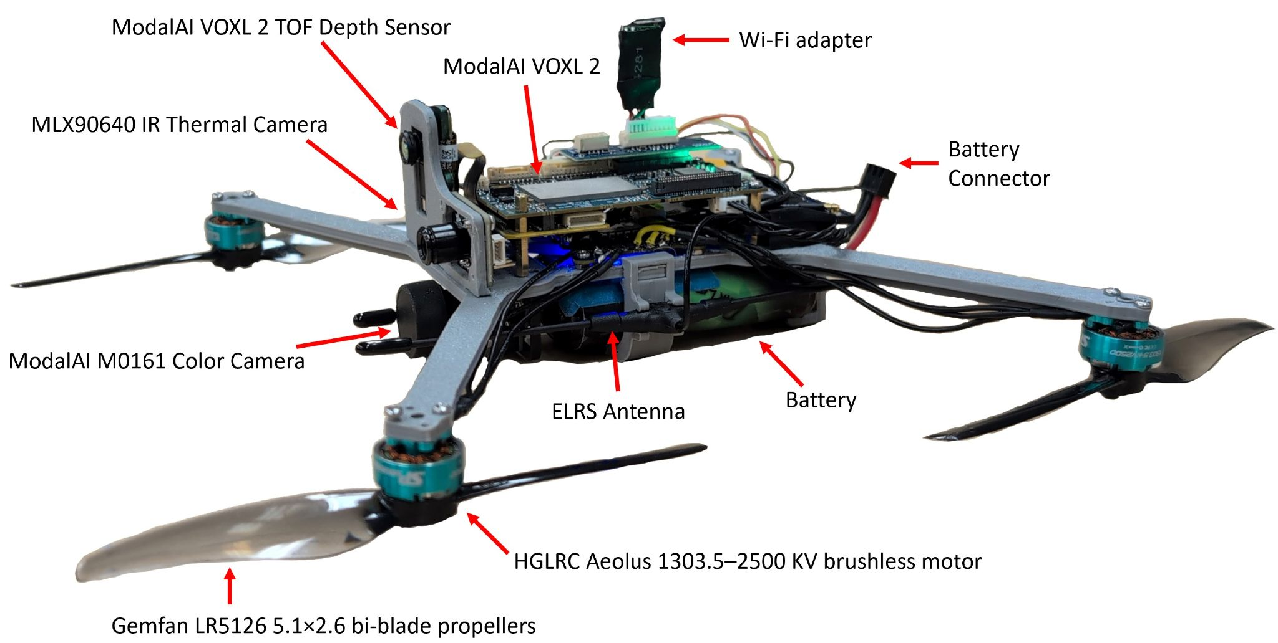
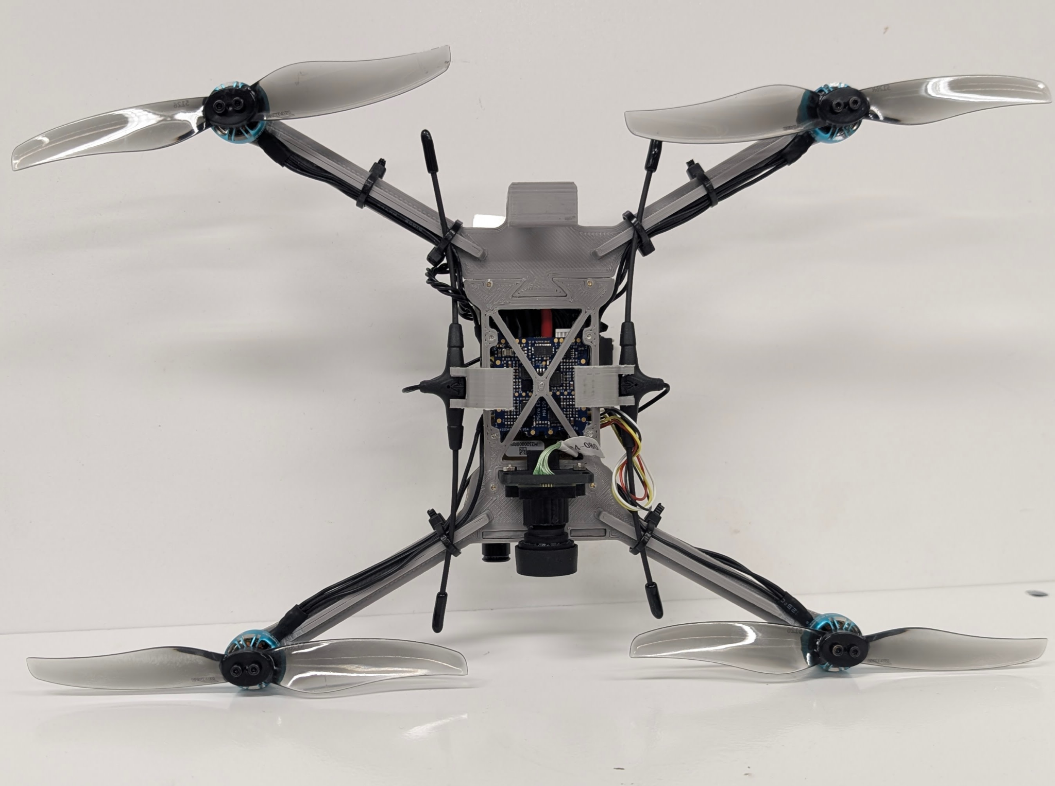
Assembled MAD Drone

Slide 9
What Is Robotic Operating System (ROS) 2?
The distributed messaging framework that lets every sensor, algorithm, and actuator on the platform talk to each other in real time.
Core Concepts
Nodes: independent processes, each handling one job: a sensor driver, a filter, a planner.
Topics: a publish/subscribe bus; nodes publish data without knowing who's listening.
Services & Actions: request/response calls and long-running tasks with feedback.
Parameters: runtime configuration values a node can read without restarting.
Why ROS 2 for This Platform
DDS-based transport gives real-time, low-latency messaging suited to flight control.
Modular nodes let sensors swap in and out without touching the rest of the pipeline, and bridge cleanly into Unreal Engine for the live 3D digital twin.
The same node graph runs unmodified from a laptop simulation to the onboard companion computer.

Slide 10
ROS 2 Architecture & Node Structure
VOXL Sensor Publisher
VIO, tracking camera, ToF point cloud
qvio_ned_to_enu
Convert NED odometry to ENU frame
camera_info_pub
Publish camera intrinsic calibration
rgb_compression
Compress imagery to cut bandwidth
EKF Fusion
Refined state on /odometry/filtered
RTAB-Map SLAM
2D occupancy + 3D point cloud map

Slide 11
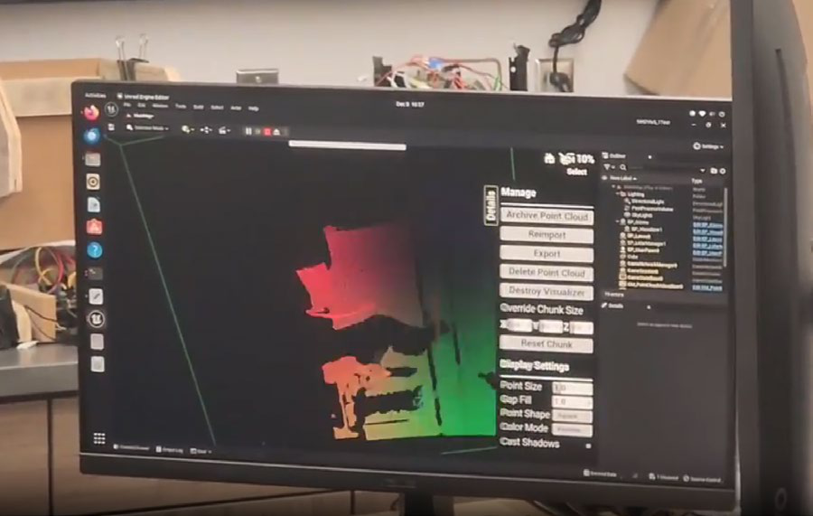
ROS 2 → Unreal Engine Digital Twin
The rclUE bridge (Rapyuta Robotics) links ROS 2 and Unreal Engine, letting Unreal actors behave as full ROS 2 nodes — publishing and subscribing to topics bidirectionally.
Point cloud (sensor_msgs/PointCloud2) is published over ROS 2.
An rclUE subscriber picks it up; a script parses it into an Unreal LiDAR Point Cloud (LPC).
Unreal renders the cloud in 3D — with camera navigation and live LPC transforms.
Result: real-time wireless visualization of drone-mounted sensor data.

Slide 12
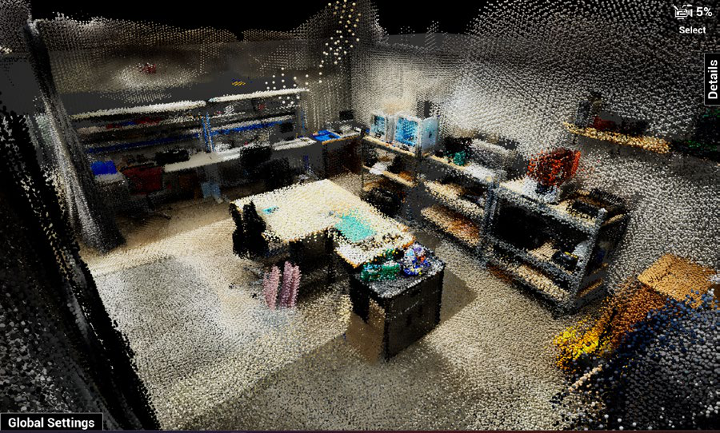
Demonstrated Result: Real-Time 3D Reconstruction
The full pipeline: RGB + ToF depth through ROS 2 to Unreal which produces a colorized 3D reconstruction immediately recognizable as the indoor lab environment.

Slide 13
Conclusions
1
Integrated platform delivered
An attritable sub-250g UAV, ground control station, and visualization interface — working together.
2
Autonomy in GPS-denied interiors
VOXL 2 compute with RTAB-Map SLAM enables navigation where GPS fails.
3
Validated data pipeline
ROS 2-to-Unreal demonstrated, rendering live UAV data into a high-fidelity 3D digital twin.
4
Data into decisions
High-resolution ToF depth yields reconstructions that support real-time situational awareness.

